Slide 1
Enterprise Architecture
Runway 2 Target State
Prepared by Chief Architect
Aug-2022

Slide 2
The AIM of THIS Presentation
The Domain Model
The Working Assumptions
Principles used in the Design
Context, A Product based organization
Enterprise Services
Enterprise Data Model
Emperies Technology Capabilities
Composite Solution Specification
Deployment Diagram
Endorsement Request
Proposed Architecture Governance

Slide 3
Target State – AIM of THIS Presentation
This Document outlines the TARGET state of the HKJC from various Architecture views
The Enterprise Views show the PRIMITIVE Building Blocks Required to Support the Target State
The Composite Views show the Deployment outlines from a Capability/Service View and then from a Deployment View
The Document does not indicate the transitional states, which can only be derived once the TARGET state is approved.
To seek ENDORSEMENT for the ARCHITECTURE TARGET STATE

Slide 4
Target State - Assumptions
Architecture
Enterprise Service’s Default
Loosely Coupled Services
Micro / Macro Services
New Data Center AND Network, in-place, Leveraging Cloud Services
Consolidated Active Dir.
Consolidated DNS etc…
Message Orientated
Standardized Data Structures
Publish/Subscribe Default
Using Golden Sources
Transitional States will follow
Delivery
Agile Delivery Model
Central Scaled Development
Central Operations Team
Formal Governance by Change Req.
Transitional States will follow

Slide 5
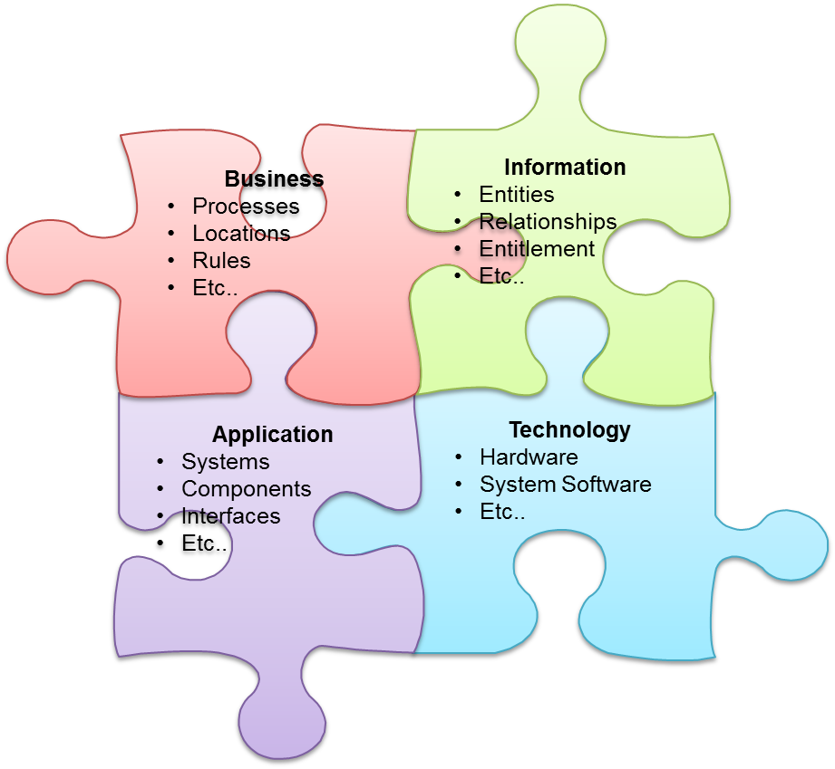
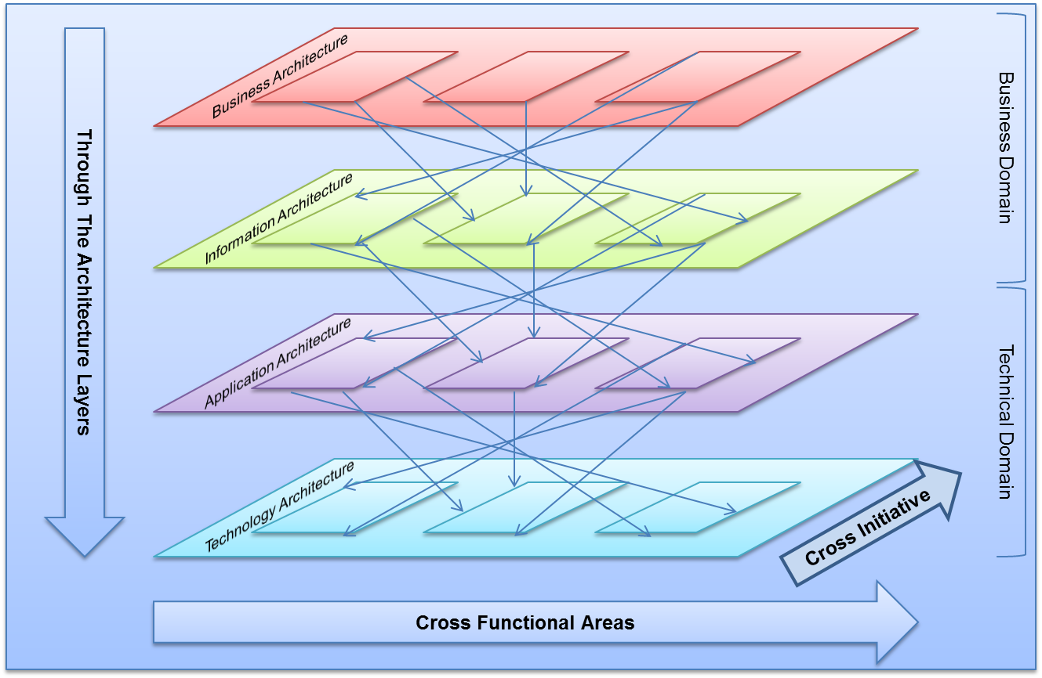
Architecture Domains
Chief Architect
Mark
Enterprise
Vision / Principles etc…
Functional
Business / Data
Shared Services
Apps / Technology
Business
Mark
Wagering
Samuel / Carlos / Kenny
Wayne / George
Infra. & Automation
Vincent
Michael
Data
Michael
Equine
Peter
Wayne
Channels & Int.
Chris
Chirag
Applications
Dep
Key
 | Role
 | Architect
 | Domain
 | Domain Views
 | Sub Domain
 | Architect
 | HoD Delivery
 | Direct Report
 | Matrix Mgt
Customer
Kelvin
Roy
Analytics
Kenny
Roy
Technology
John
Security
Vacant
Corporate
Vacant
Roy
Security
Vacant
Dirk

Slide 6
Architecture Principles
Business | Information | Service | Technology
Primacy of Principles | Data is an Asset | Single Responsibility | Requirements-Based Change
Reliable Operation | Common Vocabulary and Data Definitions | Technology Independence | Limit Technology Diversity
Appropriate Security | Data Mastery | Consistent Interface | Managed Technology Variance
Managed Services | Data is Shared | Reuse over Buy over Build | Promote Interoperability
Measured Processes | Data is Accessible | Modular delivery of Services | Standards based systems
Fit to the Clubs Business Strategy | Data Trustee | Reliable Data transfer | Systems can be monitored
“Customers” of the Club | Information Security | Data access via Interfaces | Technology Adoption Independent of Skills
Straightforward and Consistent Service | Information must be traceable | Accessing External Data is controlled | Incremental Growth, Predictable Costs
Standard Service Interface | Information classification should be managed | Distributed Data Integrity | Proven Technology Preferred
Timely Product and Service Delivery | Data should be physically controlled | Ease of Use and Branding | Managed Obsolescence
Reliable Delivery | Data should be distributed via standardised channels | User Interface Channel Independence
Stakeholder-focused Services | Data should be distributed in a standardised structure | Reuse Security and Access Control Components
Value for Money | Data replication should be managed in a standardised manner | Common Use of Services
Maximise Benefit to the Club. | Data changes should be traceable | Loosely coupled Services
Information Management is Everybody's Business | Data should be edited in a standardised manner | Services are Managed and Controlled
Business Continuity
Compliance

Slide 7
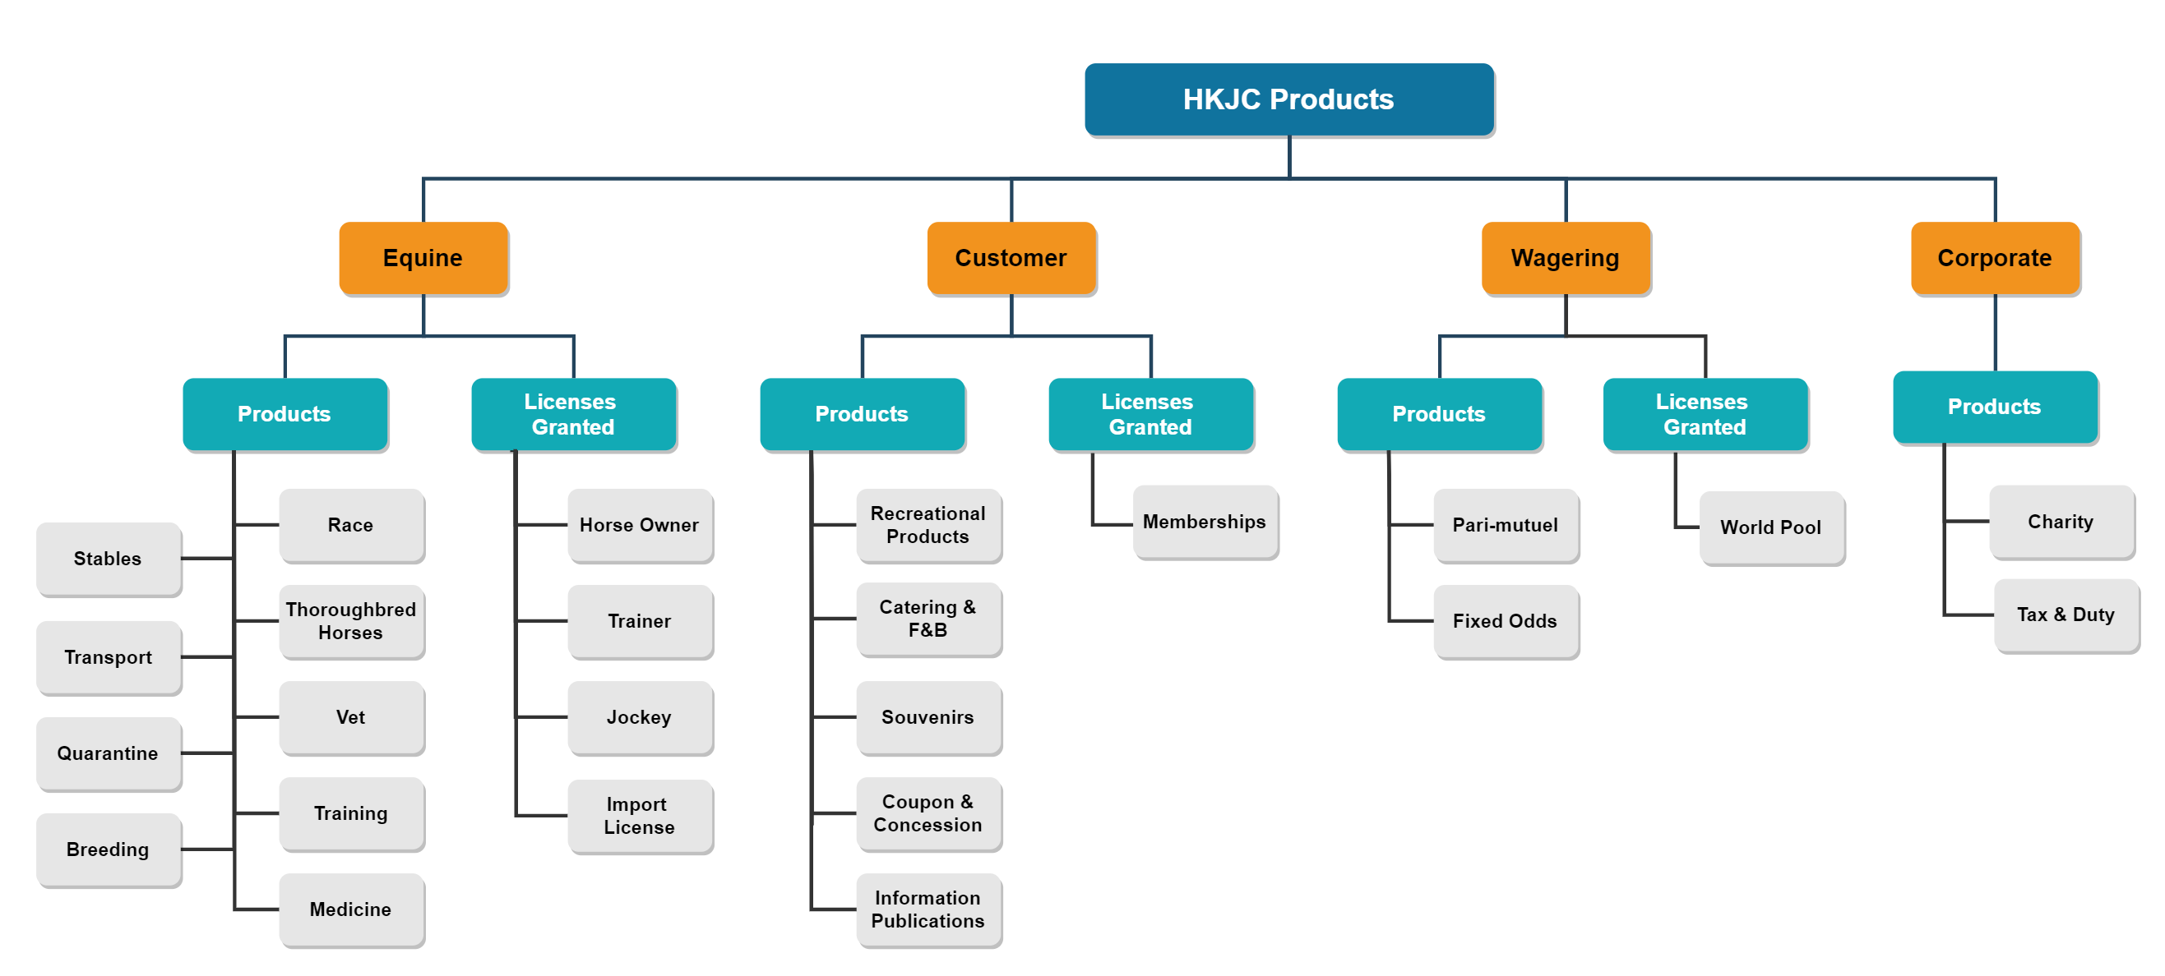
Context; Business Domain - Products of the Club
HKJC is a SALES Organization

Slide 8
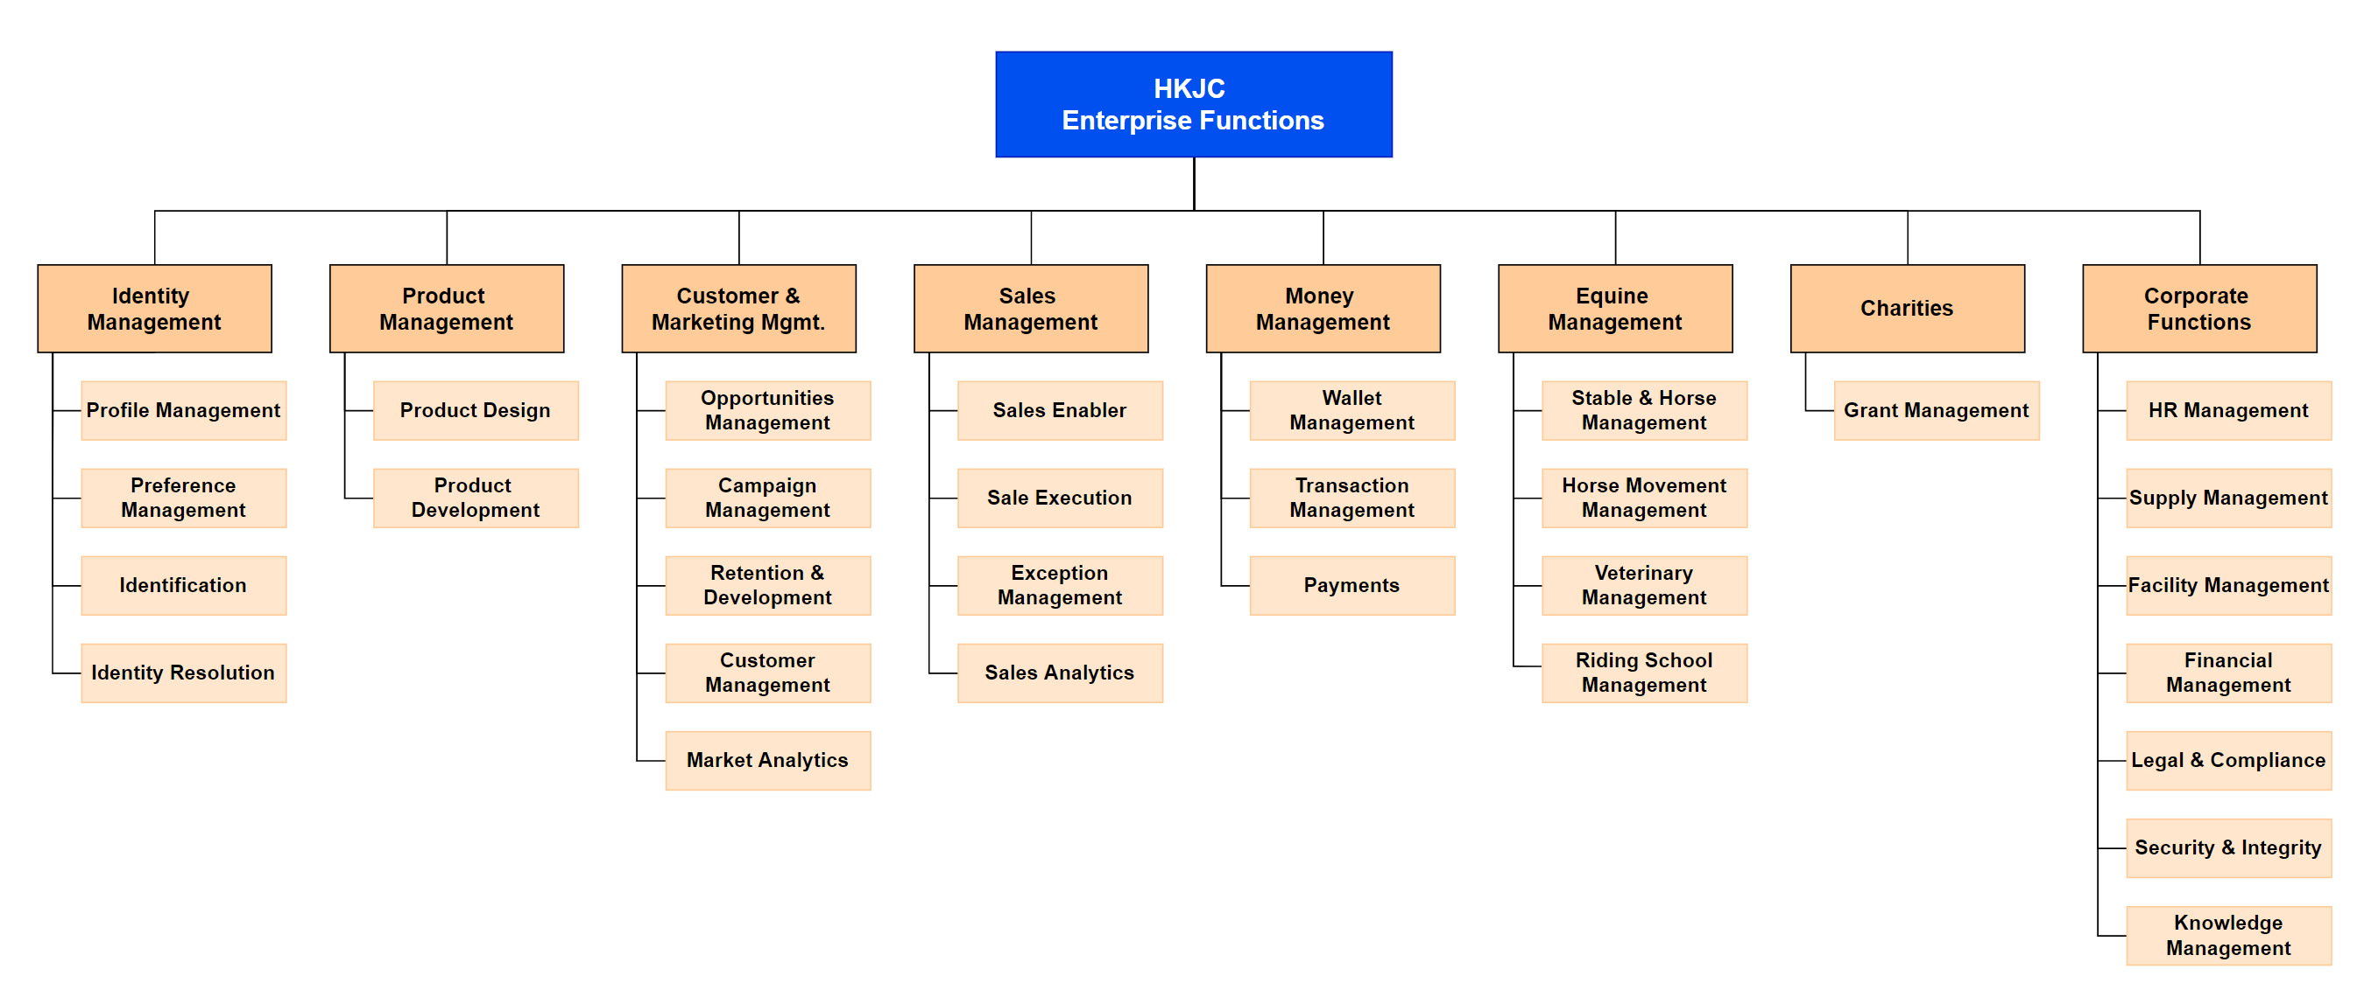
Enterprise Services Domain – Enterprise Capabilities

Slide 9
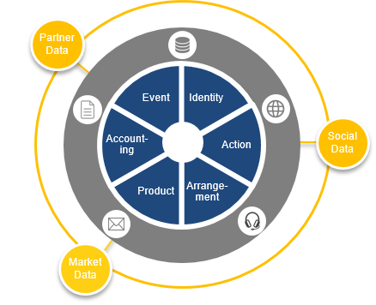
Data Domain – Canonical Data Model
Draft for Discussion
Party
Person
Action
Product
Event
Arrangement
Account
Organization
IDInformation
Role
Demographic
Preference
Association
Contact
ClubAccount
Interaction
Method
Channel
Lifecycle
Group
Catalog
Offering
Entitlement
Asset
Usage
Group
Type
Stats
Schedule
Attendance
Instruction
Agreement
Fulfillment
Transaction
Involvement
Terms
Mandate
Contract
Activity
Billing
Statement
Fund
Fee
Payment
Rule
Tax
Payout
Holding
Settlement
SubAccount
Outcome
Consent
Pet
Metadata
Content
Reference : bian.org , schema.org,

Slide 10
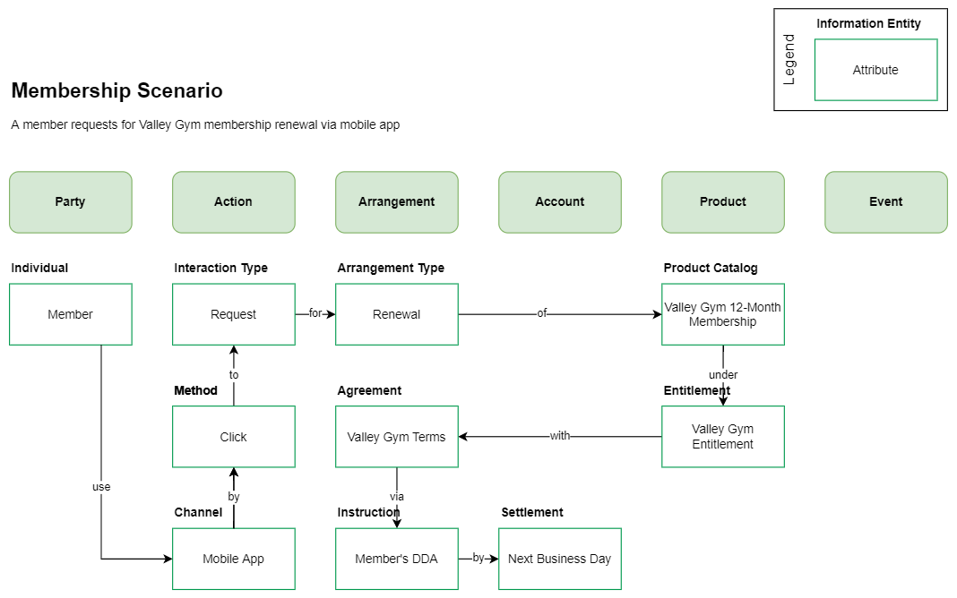
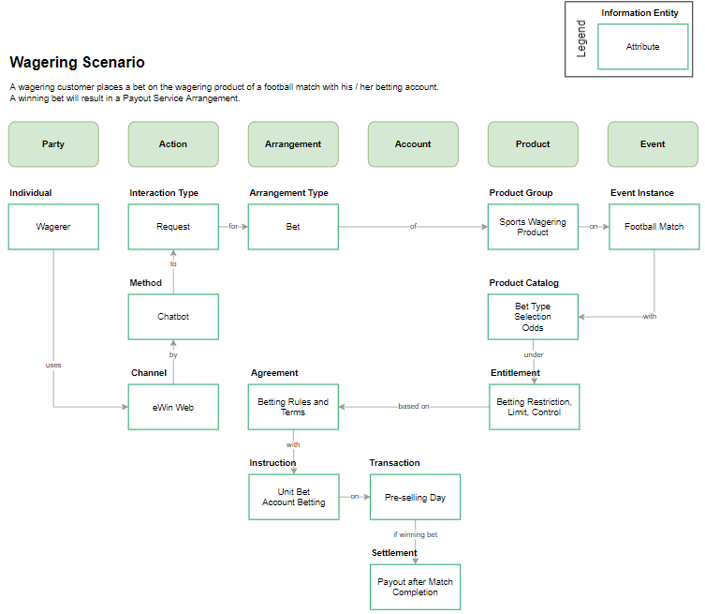
Data Domain – Canonical Data Model (Illustration)
Draft for Discussion

Slide 11
Enterprise Technology Domain – Technology Capabilities
Business Package
Channels & Int.
Infra. & Automation
Identification and Authentication
Non-Repudiation
Detection and Notification
Integrity
Service Integration
Broadcasting
Content Delivery & Caching
Gateway Services
User Interaction Services
Content Management
Process Management
Business Rule Management
Business Process Management
Service Build
Technologies
AI ML Model
Deep Learning
Natural Language Processing
Analytical Data Processing
Master Data Management
Artificial Intelligence
CI/CD/CT Automation
Monitoring Services
Systems Management
Event Collection and Event Tracking
Security
Robotics
Software Engineering
Collaboration Management
Configuration Management
Testing
Information Storage
Platforms
Desktop Services
Network Devices & Services
Office Services
Internet of Things (IoT)
Package Solution
SaaS solution
Vision AI
Application Management
Object Storage
Distributed Tracing
Micro Service
Cloud Platform
Machine Learning
Cloud
Data Fabric
Data Governance
Data Management
Business Intelligence
Analytical Data Provision
Analytics

Slide 12
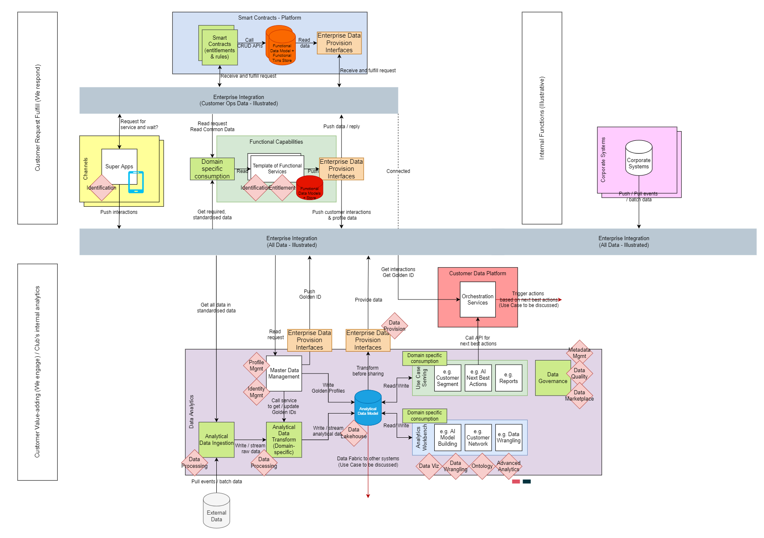
Solution Domain – Composite Target State

Slide 13
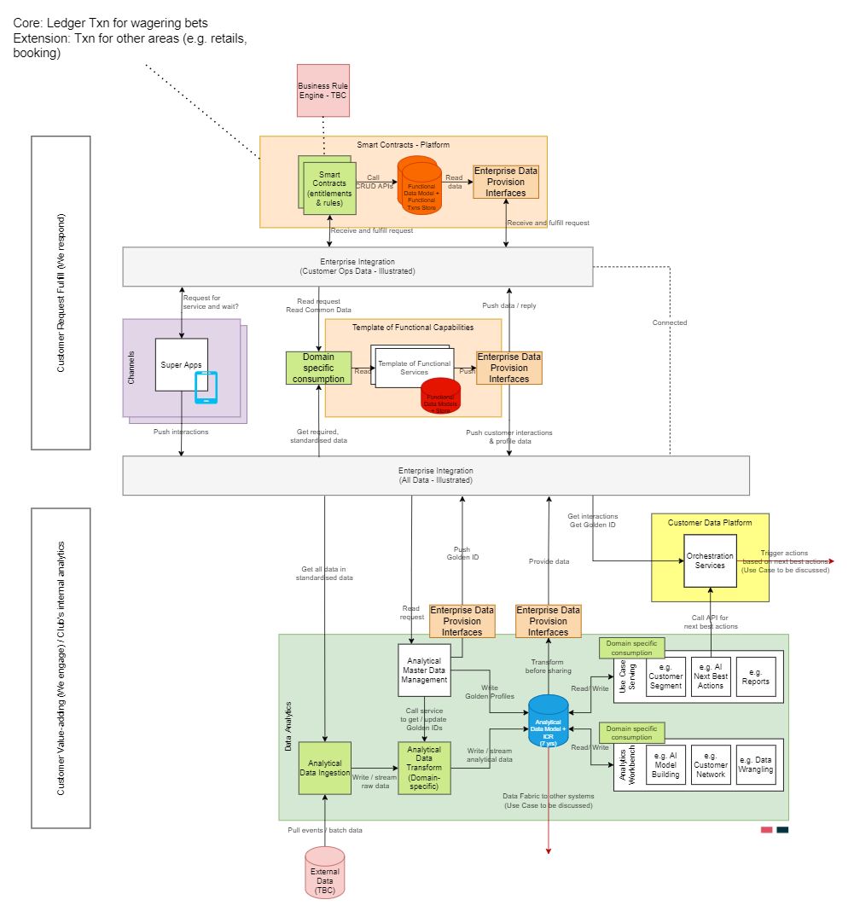
Solution Domain – Composite Target State

Slide 14
Solution Domain – Deployment Diagram (Hybrid Cloud)

Slide 15
Endorsement Request
Request | Endorsement (Y/N) | Comments (If any)
Approve Architecture Target State, as-is
Approve Architecture Target State, with Changes
Reject and Request More information
Reject and Request Wider Consultation
£
£
£
£

Slide 16
Proposed ARCHITECTURE Governance Model
5.1. Technology TSG, if change to technology is determined.
1. Architecture artifacts in place, including Ref Arch, Policies, Patterns & Taxonomies for:
Enterprise Domains
Shared Services Domains
Functional Domains
Functional Relationship Matrix maps Functional and Services domain, see Appendix 2 for details.
7. Architecture Assurance Review is a new gate and is mandatory prior to RMB review.
5.2. SGB¹ if Service needs to change or there is a dispute (functional services)
Change request(s)
4. OI is approved and converted to a project
8. Release Management Board review.
2. OI is drafted
5.3. ADB participation is by exception. Project requires ADB review only if architecture solution deviates from standards.
9. Go live
3. Functional architect to produce Proposed OI Architecture (in the form of ADS), indicating which services should be used to implement the solution.
5.4. DGB, should there be a dispute on data ownership.
Legend
Existing
New
Optional
6. ITEC review takes place when architectural standard change was approved, or rejected.
Design & Build
¹ Service Governance Board

Slide 17
Next Steps
Once Endorsement is received
Syndicate the target state
Map the Departmental Capabilities to the Enterprise Capabilities and assign ownership
Work with the Delivery teams to create a Program Plan for Runway 2, WITH dependencies

Slide 18
Enterprise Data Governance Framework

Slide 19
For Information
Recap Data Governance Programme – Objectives
Achieve consistent interpretation of data by establishing a common data definition
Facilitate reuse of data, applications and system components
Identify what data to protect and how to help keep it protected through a risk based, governed approach
Improve data handling and monitoring process to enhance data quality and integrity

Slide 20
Challenge and Expected Outcome
Draft for Discussion
Objectives of Data Governance
Challenge
Solution
Expected Outcome
Legacy systems and silo/custom applications pay heavy toll on translation & maintenance within and across domains
1. Standard Data Structure
Common data schema as single language used across organization agnostic to infrastructure and applications
Data fragmentation and ownership burden and complicate data ingestion, consumption and analytics
2. Data as a Product & Data Catalog
Data consumers are “customers” and data “producer” promote reusability with clean, reliable and available data as a “products”
Data is not consistently tracked increases time, cost, difficulty to meet regulatory & compliance requirement
3. Data Lineage & Change Audit Log
Reduce effort for impact analysis, risk assessment, access control, compliance reports and AL/ML modeling
Integration spaghetti and stale data causing customer satisfaction and operational issues
4. Real-Time Data Delivery & Tracking
Ability to quickly response to customer requests, market changes and support proactive decision making & analytics
Enterprise Data Governance Framework
Notes:
Data products are produced in clean, reliable and available by owner domain who understand the data
Establish data lineage to support reproducibility, traceability, and verifiability

Slide 21





















Modernized Data Governance
Draft for Discussion
Everything to Customer
Business Owned Data ◦ Product Use Case Driven ◦ Trusted Data
1. Standard Data Structure
3. Data Lineage & Change Audit Log
API /
Message
Canonical Data Model ◦ Single Common Language ◦ Business Descriptive
Distribute as Events ◦ Immutable Change Log
◦ Aggregated Data Changes and Catalogs
Standard Report
Domain A
Domain B
Domain C
Partner Data
External Data
Dashboard
Party
Action
Arrange-ment
Product
Account
Event
Statistical Analysis
Structured Data
ingest
produce
ingest
produce
ingest
produce
Social Data
Forecast
GeML
(common schema markup)
Enterprise Event Streaming Platform
Sentiment Analysis
Unstructured Data
2. Data as a Product & Catalog
4. Real-Time Data Delivery & Tracking
Next Best Action
Market Data
Data as Product ◦ Local Autonomy
◦ Data API ◦ Data Infrastructure Platform
Data Mesh ◦ Data Provisioning
◦ Event Streaming Platform
Prediction
Optimization
Interoperable ◦ Observable ◦ Discoverable ◦ Changeable ◦ Addressable ◦ Secured ◦ Trustworthy
Automation Action
Enterprise Data Governance Framework
Data Flow
Pub/Sub
Operational Data
Engagement Data
Enterprise Data Management
Change Audit Log
Data Steward
Data Governor
Data Product Domain (Enabler Team)
Customer
Data Consumer
Publish
Interact
Analytic
Data
Data Product
External Source
Notes:
Enterprise Data Governance -> proactive, computational, interoperable

Slide 22
Issues to address by
Draft for Discussion
1. Standard Data Structure & 2. Data as a Product & Data Catalog – can help to address:
Comparing Apple to Orange - Data collected from different sources lack common structure and increase data wrangling effort
Duplicate Data Entry & Queries - attempted use of CRM systems as master customer data creates technical debt and burden application teams
Inaccurate Data – expecting data captured has missing fields, error or insufficient information
Too Much Data – data is dumped vs being organized, some data stores became data swamp
Lack of Data Ownership – uncertain about the data collected are considered as the source of truth in time
Compliance Hurdles – controls are not embedded onto data collection and protection for validation e.g. PDPO (HK) or PIPL (China)
Hard to Understand Data Lifecycle – data grows in size and complexity, people changes and different transformation make it difficult for clarify and visibility to data team
Data Silos – lack of accessibility increase complexity for aggregation and consolidation for analytics
Pace of Technology – legacy technologies limit the acceleration and capability of data centric strategies
Lack of Commitment – service level agreement couldn’t be met because expectation of dependent of data (and also service) from different systems are varied and/or expensive to match
Lack of Self Service Infrastructure – separate data solutions and operation are costly and increase technical risk and debt for data acquisition, storage, preparation, delivery and governance
Ad-hoc Data Preparation – reliance on manual effort and on-demand basis which usually expensive and take long time to implement
Mars and Venus – data are usually technical oriented among IT teams however users expect business descriptive
Unable to Scale - existing data model is not designed to scale for enterprise and international use
Notes:
Data products are produced in clean, reliable and available by owner domain who understand the data
Establish data lineage to support reproducibility, traceability, and verifiability

Slide 23


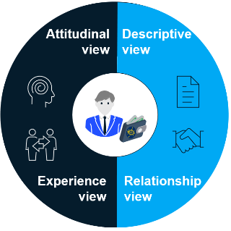

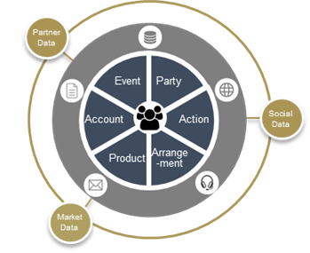
Customer Centricity
Focus on a “bounded context” instead of boiling the ocean!
Marco’s winning day at the racecourse
1
Descriptive
4
Breakfast at Shatin Clubhouse
Attitudinal
Marco visited the Clubhouse for breakfast. Given his status,his butler arranged priority parking and a table at Oi Suen for his family. He happily enjoyed his favorite set of dim sum there.
Celebrating horse win at the Owner Box
Marco’s horse Gold Strike won! The staff in the Owner box organized a surprise party to celebrate his horse's 20th win. The butler requested a specially curated menu
for his family. Marco took pride in his experience and excitedly invited his friends.
2
Engagement
Arrival at Shatin Racecourse
3
Marco’s dedicated relationship manager warmly welcomes him at the racecourse and assisted him in placing his usual bet types. The racecourse staff accessed his profile and wished him and his horse,
Experience
Dining and socializing at the racecourse
Gold Strike, good luck.
Marco was invited to an invitation-only VIP party. He had a
great time mingling with other horse owners and business tycoons. He then returned to the Owner Box to cheer for his horse.
Customer Centric Canonical Data Model
Notes:
Descriptive
This includes demographic data like gender, age, geography and income. It also includes self-described attitudes and preferences toward products categories and technology. From this data you can create meaningful segments (e.g. early adopters or value-seekers) and personas. You can collect this data from purchases, registrations, surveys, interviews and contextual inquires.
Attitudinal
Preference data, opinions, desirability, branding and sentiments are usually captured in surveys, focus groups and usability tests. This is where questionnaires like the SUPR-Q, SUS or the Net Promoter Score quantify how interactions and behaviors affect attitudes. These attitudes will then affect some self-described descriptive attributes quantified in the descriptive grouping.
Descriptive
Where customer live and work, what are the current
and past functional roles, industry association and
affiliation, authority and entitlement customer
play and involve, which age, ethnic, racial
religion groups customer belong etc. are
important data to determine the customer
outreach strategy, risk and compliance.
Behavioral
The actions customer take through
different channels – mobile apps, social
network, OCBB are data with implicit and
explicit content preference. Combining with
activities customer involve like attendance,
events, entertainment, meetings etc. provide
necessary engagement data about customer journey.
Financial
Average costs to sell and serve customer,
Investment in the customer including annual
and cumulative over time. Cost per transaction,
Return or Investment and customer profitability.
These are calculated base on statistical financial
activities and patterns of customer’s accounting data.
Transactional
Customers wagering and purchasing history, their BANT
(Budget, Authority, Needs, Timeline) & the respective
cycles, arrangements, the time, place, how and
what methods are captured per transaction.
Transitional data is used for sale, servicing,
marketing of products and services.

Slide 24



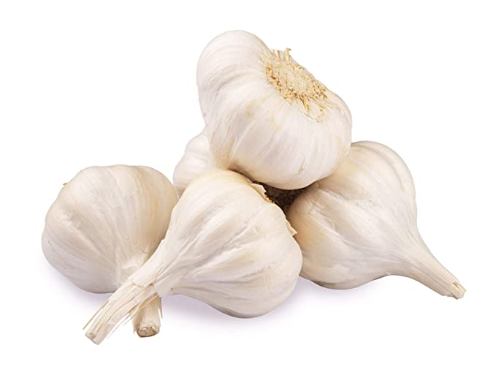





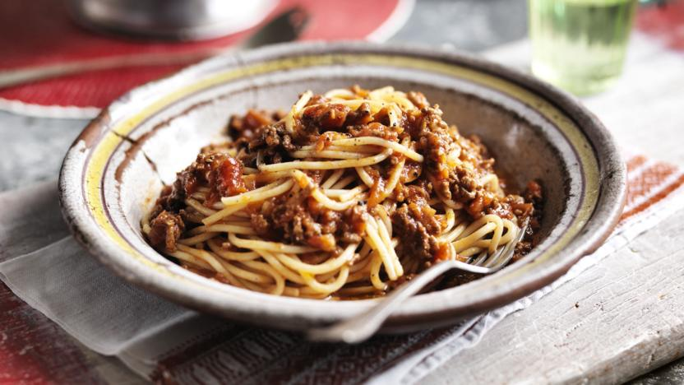



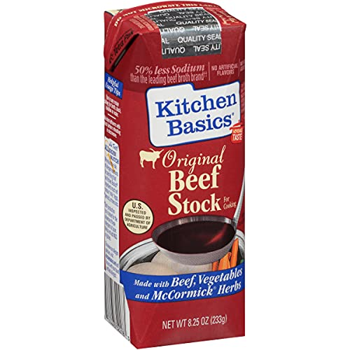
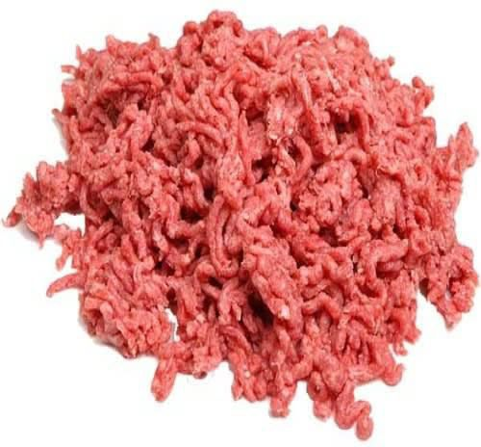
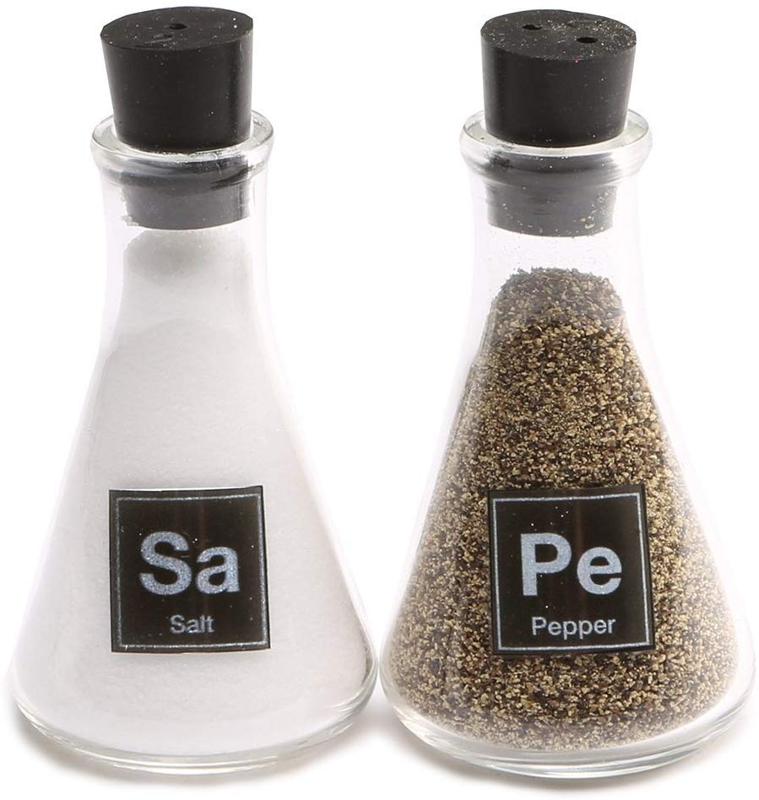
Data Driven Culture
“A product that facilitates an end goal through the use of data” #
Data as a Product
“I need to produce products customers will keep buying!”
scenario: Mum is making a dish for a kid’s party!
Producers
“products are available on shelf easy to find ”
Consumers
“Products are clearly labelled and I done shopping in 15mins”
“Kids in the party love it!”
“They are really fresh!”
“Need to stock take and see which are the best or to improve”
“They are easy to cook!”
Data Catalog
# Book - Data Jujitsu: The Art of Turning Data into Product, 2012 – DJ Patil

Slide 25
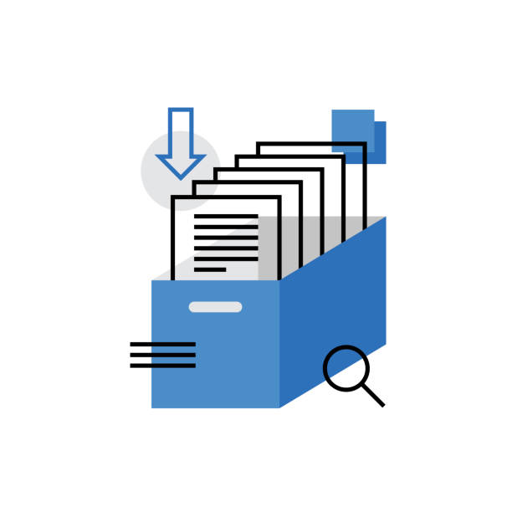
Data Catalog - Benefits Derived
Increased Productivity – Analysts & Scientists
Improved Data Comprehension through an agreed Common Data Standard, Business Rules & Format
Enabled Collaboration – easily understand ownership, stewards, SME’s
Minimized the risk of data misuse – certified, trusted, classified
Removed IT bottlenecks – self service
Greater exposure and interpretation of data policies

Slide 26
Canonical Data Model – revisit the ‘why’!
With Canonical Data Model
System A
System A
N (N-1)
N x2
System E
System B
System E
CDM
System B
Perform fewer translation
Improve translation maintenance
Enhance logic maintenance
System D
System C
System D
System C
Common Understanding of Business Data
Reduction of Processing overhead
Reduction of Integration costs
Notes:
Advantages of Canonical Data Models
Common understanding of business data - It often happens that various teams within an organisation have different terminology for the same entity. A CDM promotes a common definition to eliminate ambiguity, errors of interpretation, and miscommunication.
Reduction of processing overhead - Data transformation is one of many contributors to processing overhead. Once the CDM or subsets of it is implemented across the enterprise, the mappings between applications will no longer be required. This results in driving down the processing overhead and increasing application performance.
Reduction of integration costs - Applications transform once to the CDM, as opposed to multiple transformations between systems in point-to-point integration, ensuring the impact of schema changes are minimised. Creating your “canonical” view of what an entity looks like and realising it within your middleware can help shield you from changes in the future.

Slide 27
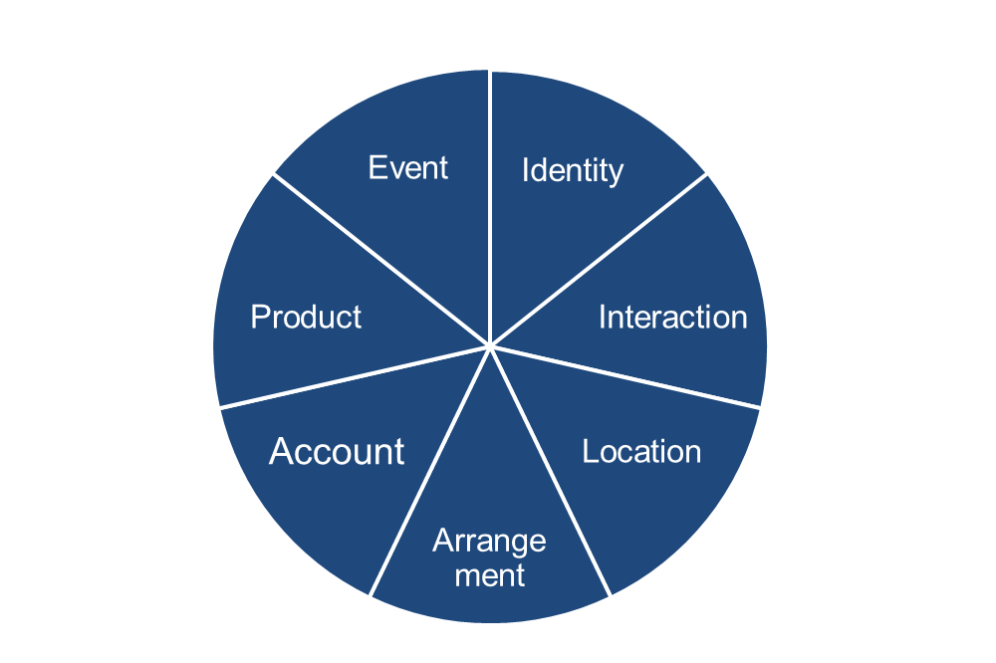



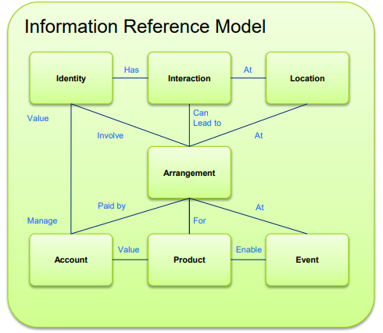
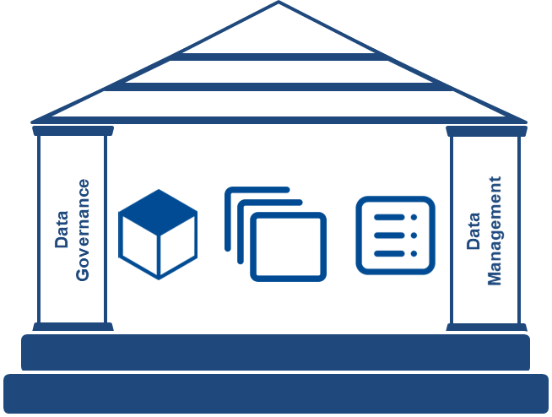
Canonical Data Model – Current & Target State
Current Canonical Data Model developed 8 years ago is not sufficient to support the future requirements!
Current
Target
Local Need
Global Need
Full Descriptive
(Entity, Class, Attribute)
Entity Descriptive only
Homogenous Schema Integration
Heterogeneous Schema Integration
Self-Managed
Federated / Continuous Governed
Notes:
Requirement:
Local Need
Global Need
Definition:
Entity Descriptive only
Full Descriptive
Schematic:
Homogenous Schema – each system/domain design and implement of the own local schemas and data integration requires schematic translation
Heterogeneous Schema Integration - aims to integrate different types of local schemas, which may be written in different data models or may be designed independently, into an integrated schema for sharing information on a global basis
Governance:
Self-Managed
Federated / Continuous Governed

Slide 28
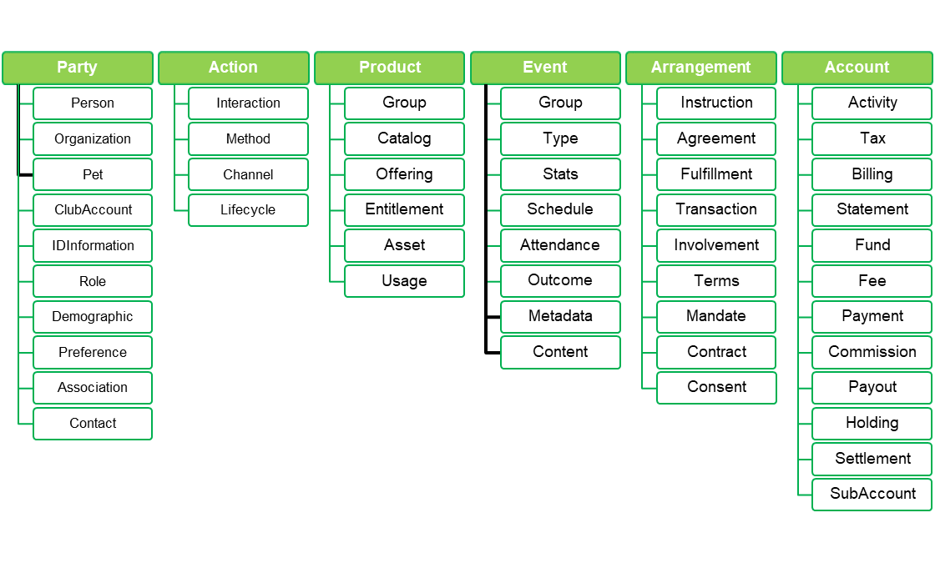
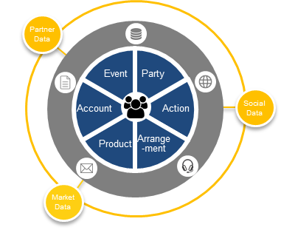
1. Standard Data Structure Architecture
Draft for Discussion
Vision to be the industry standard and enable data ecosystem within the club and external partners
Leverage open structured data markup schema
Common vocabularies (markup schemas) are well defined by some open communities e.g. W3C schema.org, SportsML, FPML for which are practiced globally, including Google, Microsoft, Pinterest, BCC, ESPN etc. By leveraging the vocabularies combining with HKJC specific schemas with ACL pattern will ease the integration between HKJC and unstructured data / external data.
Immutable but extensible
CDM does not attempt to describe “all things” happen in the organization or as a merge of all data models. Its reflects the common vocabulary of the domains thus the core structures (entities and relationships) are not expect to change. However the attributes of entities are extensible to suit the domain specific needs through a continuous federated data governance
International and reusable design
The design of data schema should support Multi-currency, Multi BU (entity), Multi region/local regulation, with common attributes to promote reusability and operation efficiency e.g. unique ID, effective timestamp, originator etc.
Less translation and logic maintenance
CDM contains both entities (things that exist) and relationships (how they interact with one another). When just a single system changes, you only need to verify the translations to and from the CDM instead of verifying translation to every connecting system. Similarly since logic is implicitly embedded in the CDM, so any system change is only require to verify logic within CDM.
Technology Agnostic
CDM is a mechanism for understanding the business problems faced, not the solutions involved, and as such, must be independent of the selected solutions in order to provide value to the practicing domains and synthesizes the data integration requirements of all relevant applications.
Notes:
Canonical Data Model (CDM) is an abstract framework and data reference model enables information sharing and reusable data schemas across domains
Consumer-centric instead of producer-centric

Slide 29
2. Data Product and Data Catalog Architecture
Draft for Discussion
Data as a Product minimizes the cost of discovering, understanding, trusting and ultimately using quality data
All Data within a Data Product are accessible using APIs
Each (data) API’s contract is defined by a formal contract follows Integration Service specification*. Each specification defines the request, response, error, and security definition requires to access data platform in a standard and secure manner. Each API request is considered an “event” which can no only read/write data but also communicate state changes.
Each data product has a catalog of its data
The data product catalog describes data products understood by data consumers (meta-data) Changes to data product catalog are captured and sent in near real-time to the Enterprise Data Product Catalog
Data Products are produced with commitment for consumption
Data Product is node composited from a set of operational, analytics and engagement data of different data stores, for which has its own lifecycle, built autonomously and has commitment for consumption.
Data Product APIs
Data Product
Data Product Catalog
Enterprise Data Management
Enterprise Data Management consolidates all data platform catalogs
Each Data Product Domain maintains data stores on its own data platform
Change / Audit Log (Immutable)
The persistent information store about club’s data – enterprise level meta-data, master data and reference data provides active crucial data profile, data security and data quality that supports the Federated Data Governance Framework
Databases, data warehouse, data lakes, data mart are owned and managed by the data product domain on a common shared data platform (infrastructure as service) Data stores should support both operational, analytic, and engagement data for its specific Business domain.
Operational
Data
Analytic
Data
Engagement Data
Change Data Capture
Enterprise Event Streaming Platform (Solace)

Slide 30
3. Data Lineage and Change Audit Log Architecture
Draft for Discussion
The aggregated list of changes data undergoes is crucial for governance and regulatory purpose
All changes to data are captured for audit and governance purposes
All changes to a data product (including its operational, analytic and engagement data) is captured automatically and managed in an immutable log. This log supports federated data governance framework for data linage, integrity and quality
All changes in data are captured and distributed as events
All changes in operational, analytic and engagement data must be captured and distributed as “events” follow the Integration Service Specification* within the data product domain, or to interested parties outside of the data product domain
Data Product APIs
Aggregated data changes and catalog in one repository
Data Product
Data Product Catalog
Enterprise Data Management
A synchronized aggregation of all Data Product catalogs and data changes is used to make it easy for any user or developer to find, consume, and govern any data across the enterprise,
Enterprise Data Management uses this data to provide a searchable index of meta-data — which explicitly includes references to each Data Product’s immutable change/audit log — allows data lineage to be easily discovered and confirmed.
Loosely coupled enterprise event streaming platform across domains
Operational
Data
Analytic
Data
Engagement Data
Change / Audit Log (Immutable)
Leverage enterprise event streaming platform (Solace) as backbone, all events are communicated across the organization (including inside the data product domain) This loosely couple design minimize the cross impact of changing systems
Change Data Capture
Enterprise Event Streaming Platform (Solace)
Notes:
A lakehouse architecture would address this by automating compliance procedures – perhaps even anonymizing data where it was needed
A data lakehouses are inexpensive to scale because integrating new data sources is automated – they don’t have to be made to manually fit with the organization's data formats and schema
They are also "open," meaning that the data can be queried from anywhere using any tool, rather than limited to being accessed through applications that can only handle structured data (such as SQL)

Slide 31
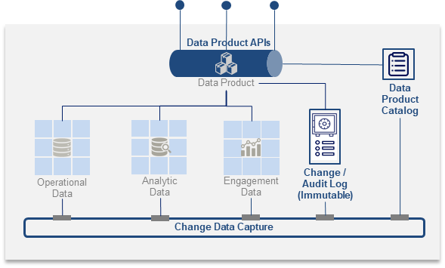
4. Real-Time Data Delivery & Tracking Architecture
Draft for Discussion
An enterprise data mesh simplifies the delivery and monitoring of data products across an organization
Enterprise Data Management provides the policies and standards for data delivery and tracking
Enterprise Data Management supports Federated Data Governance Framework to ensure safe, reliable and scalable transaction, event communication and data exchange across domains by implicitly embedding the principles and controls for automating compliance and audit purpose
Customer data product domain
Wagering data product domain
Equine data product domain
A Data Product domain contains many data products
Clean, reliable and timely data products are produced by each data product domain, for which supporting the core business functions and capabilities of the organization
Enterprise Data Management
Data Mesh provides near real time data tracking inside, and between data platforms
Data is transmitted in near real-time inside a domain using a “change data capture” (CDC) mechanism and an event streaming platform to keep domain operations, analytics data in sync.
End-to-end data is transmitted between domains in near real-time by capturing local domain data CDC events and publishing them using Solace topics to interested subscribers
Enterprise Event Streaming Platform (Solace)
Data Mesh streamlines data products delivery
Data mesh domains are explicitly designed to share owning data between domains with commitment (SLA) and minimal duplication.
Date access and changes are considered “events”, sharing data between domain is facilitated through event hub (Pub/Sub+)
◦◦◦
Cooperate data product domain
Finance data product domain
Other Business Function data product domains (e.g. Marketing, Legal, HR)

Slide 32
Enterprise Data Governance Framework
Draft for Discussion
Data Governance and Data Management are the pillars to support corporate data strategy and objectives
Data Governance
Data Management
Policies, rules and controls to governing the data and managing data quality. It refers to the strategy and framework to establish process and theories
Achieve business goals and reduce risk, add truest and understanding to organization's data
Philosophical focused on an overall business strategy, and reliability and safety of data
Multiple members of an enterprise holistically build a framework for data management
Corporate
Strategy & Objective
Methods of how data is organized. It refers to the practice of collecting, organizing, protecting, processing, sorting and maintaining data
Assure the accuracy, accessibility and availability of data to be processed and analyzed
Logistical and focused on technology and increase data quality and valuably
Primarily the responsibility of IT to implement the framework to manage data
Data Strategy
Federated Data Organization Model
Data
Quality
Data Reusability
Data Security
Data
Governance
Data Management
Data Literacy
Data Compliance
Data Architecture
Policies, Standards and Processes
Corporate Organization Model
Data Metrics are the building blocks to solidify the structure
Notes:
maximize the value derived from data, build user trust, and ensure compliance by implementing required security measures
drives data democratization to embed data in all decision making, builds user trust, increases brand value, reduces the chances of compliance violations

Slide 33








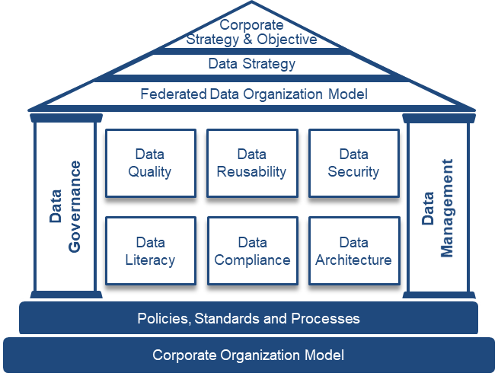


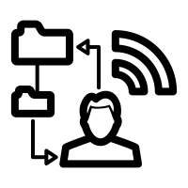



Data Standards
Draft for Discussion
Data Management applies and provides measure for data standards
Domain Data Management
Federated Support
Align
Validate
Enable
Data
Standards
of
Customer
Interoperable
Observable
Discoverable
Changeable
Addressable
Secured
Trustworthy
of
Membership
Data
Products
Consumption Layer
Govern
Codify
Provision Layer
Enterprise Data Governance
of
Wagering
Racing
of
Wagering
Sport
Provide Computational Data
Each domain implement and execute the standards through its data management platform
Notes:
Data Product Standard characteristics detail:
Interoperable – conformed to canonical data model; ability to align in common enterprise data model
Observable – provision as data API/service; ability to able constant monitoring of the behavior of the data in data pipeline
Discoverable – described in data catalog; ability to find and understand the data quickly and accurately with features to search, tag, rank, query to understand the origin (5W1H), literacy, usage, lineage, history etc.
Changeable – bound with data contract; ability to mange data change with availability, error rates, versioning, compatibility and environment through terms of service and SLA to minimize the impact
Addressable – tracked via data change log; ability to trace the lineage including the origin and flow of data
Secured – accessed with data access control; ability to align to security policy to handle access provisioning and security enforcement to ensure safe and right access
Trustworthy - heath checked by data usage;

Slide 34
Definition
Draft for Discussion
Term | Definition
Data | including Operational, analytic, and engagement data spanning databases, data warehouses, and data lakes (etc) that is organized in domains owned by a product owner
Data Events | That define and describe any state change, command, or data transmission related to the data product; Events are generated from many sources including data product APIs (each request can be an event), change data capture (each change in data is an event), and data catalog changes (changes in meta-data are events that are published to interested subscribers)
Data Product APIs | that make data within a data product accessible via a contract that is consistent, uniform, and compliant to industry standard specifications (OpenAPI, or any other mechanism such as GraphQL, MQQT, gRPC etc)
Data Product Catalog | that describe the data residing in the data product while providing a user interface and APIs that make it easy for both users and machines to consume data products; Data product catalogs integrate into an enterprise data catalog which provides a consistent enterprise view of all data products
Data Product Change Data Capture | that captures all changes to the data in the data product and notifies interested subscribers of those changes, making it simple to communicate changes to elements of the data product both within the data product (for example, keeping the analytics data store updated with changes to the operational databases) and to the broader organization (for example, where “account” domains may require information changes in a separate “customer” domain)
Data Product Immutable Change/Audit Log | that tracks and logs all changes to the data product to support federated governance as well as audit requirements
Enterprise Event Streaming Platform | that makes it simple to communicate data events within a data product as well as across the enterprise

Slide 35


RW2 Outcomes and Data Products
Draft for Discussion
Focus on the business outcomes using data products through data-driven design
Sharing Data
Target State
Data Product
Integration
Service
Application
Milestones
CustomerBetAccount
…
API.BetAccount
…
PlaceRaceBet
…
RW2 Programs
DLT
CDP
EDAP
Cloud Pass
CustomerProfile
…
Q.Customer
…
GetCusProfile
…
login
Place
CustomerSegment
HorseOwnerBetPattern
…
Q.CusSegment
Q.HOBetPat
…
GetBetRecommend
…
Recommend
CustomerAccess
…
LDAP.ExtCus
GetUserAuthenication
…
Use Case 3A:
Horse Population Modelling
Epic/User Stories
(outcomes)
3A5.1. Horse owner ….
Outcome
3A2.1. Horse owner’s spouse and friends…
.
Data-Driven Design
Data Profiling
Data Roadmap
Data Contract
Data Culture
3A2.1. Horse owner is invited to VIP party after
…
3A1.1. Horse owner receives active & real-time betting recommendation and place bet on Racing Touch during race event date
3A1.2. Horse owner’s relationship manager can assist to place bet for horse owner based on the recommendation or modified at the race course during race event date
3A1.3 ….

Slide 36
Everything to Customer
Draft for Discussion
Everything to Customer
Business Owned Data ◦ Product Use Case Driven ◦ Trusted Data
Structured Data Model
Data Product & Catalog
API /
Message
Canonical Data Model ◦ Single Common Language ◦ Business Descriptive
Data as Product ◦ Local Autonomy
◦ Data API ◦ Self-Service Platform
Domain A
Standard Report
Partner Data
External Data
Dashboard
ingest
produce
Party
Action
Arrange-ment
Product
Account
Event
Domain B
Statistical Analysis
Structured Data
GeML
(common schema markup)
Forecast
Social Data
ingest
produce
Sentiment Analysis
Domain C
Next Best Action
Unstructured Data
ingest
produce
Prediction
Market Data
Optimization
Federated Data Governance
Automation Action
Policy ◦ Interoperability ◦ Quality ◦ Security ◦ Privacy ◦ Compliance ◦ Documented
Data Flow
Collected to /
used from
Operational Data
Engagement Data
Enterprise Data Product Catalog
Data Consumer
Data Steward
Data Governor
Data Product Domain (Enabler Team)
Analytic
Data
Data Product
External Source
Customer
Publish
Interact

Slide 37
Everything to Customer
Draft for Discussion
Everything to Customer
Business Owned Data ◦ Product Use Case Driven ◦ Trusted Data
Structured Data Model
Data Lineage & Change Audit Log
API /
Message
Canonical Data Model ◦ Single Common Language ◦ Business Descriptive
Distribute as Events ◦ Immutable Change Log
◦ Aggregated Data Changes and Catalogs
Standard Report
Domain A
Partner Data
Domain B
Dashboard
External Data
Party
Action
Arrange-ment
Product
Account
Event
ingest
produce
Statistical Analysis
Structured Data
ingest
produce
Social Data
GeML
(common schema markup)
Enterprise Event Streaming Platform
Forecast
Sentiment Analysis
Domain C
Unstructured Data
Next Best Action
Market Data
Data Product & Catalog
ingest
produce
Real-Time Data Delivery & Sharing
Prediction
Data as Product ◦ Local Autonomy
◦ Data API ◦ Data Infrastructure Platform
Data Mesh ◦ Data Provisioning
◦ Event Streaming Platform
Optimization
Policy ◦ Interoperability ◦ Quality ◦ Security ◦ Privacy ◦ Compliance ◦ Documented
Automation Action
Federated Data Governance
Data Flow
Collected to /
used from
Operational Data
Engagement Data
Enterprise Data Product Catalog
Data Consumer
Data Steward
Data Governor
Data Product Domain (Enabler Team)
Analytic
Data
Data Product
External Source
Customer
Publish
Interact

Slide 38
Structured Data Model – Design Principles
Draft for Discussion
Vision to be the industry standard and enable data ecosystem within the club and external partners
Partner Data
Party
Action
Arrange-ment
Account
Event
Product
Social Data
Market Data

Slide 39




Customer Centricity
Draft for Discussion
Focus on a “bounded context” instead of boiling the ocean!
“Horse owner’s spouse has just moved to Shenzhen, can we offer any service to her?”
“This high-value customer has reduced the betting significantly these 3 months in the club but stay active in the market!”
Demographic
Transactional
“What is the ROI if I invest this much to this organization?”
Behavioral
Financial
“The customer has lost a lot today, should we remind him be a responsible gamer”
Customer Centric Data Model
Notes:
Demographic
Where customer live and work, what are the current
and past functional roles, industry association and
affiliation, authority and entitlement customer
play and involve, which age, ethnic, racial
religion groups customer belong etc. are
important data to determine the customer
outreach strategy, risk and compliance.
Behavioral
The actions customer take through
different channels – mobile apps, social
network, OCBB are data with implicit and
explicit content preference. Combining with
activities customer involve like attendance,
events, entertainment, meetings etc. provide
necessary engagement data about customer journey.
Financial
Average costs to sell and serve customer,
Investment in the customer including annual
and cumulative over time. Cost per transaction,
Return or Investment and customer profitability.
These are calculated base on statistical financial
activities and patterns of customer’s accounting data.
Transactional
Customers wagering and purchasing history, their BANT
(Budget, Authority, Needs, Timeline) & the respective
cycles, arrangements, the time, place, how and
what methods are captured per transaction.
Transitional data is used for sale, servicing,
marketing of products and services.

Slide 40
Canonical Data Model – Next Version
Draft for Discussion
Identity
Interaction
Location
Arrangement
Account
Product
Event
Data
Governance
Data Management
Notes:
Data Product Standard characteristics detail:
Interoperable – conformed to canonical data model; ability to align in common enterprise data model
Observable – provision as data API/service; ability to able constant monitoring of the behavior of the data in data pipeline
Discoverable – described in data catalog; ability to find and understand the data quickly and accurately with features to search, tag, rank, query to understand the origin (5W1H), literacy, usage, lineage, history etc.
Changeable – bound with data contract; ability to mange data change with availability, error rates, versioning, compatibility and environment through terms of service and SLA to minimize the impact
Addressable – tracked via data change log; ability to trace the lineage including the origin and flow of data
Secured – accessed with data access control; ability to align to security policy to handle access provisioning and security enforcement to ensure safe and right access
Trustworthy - heath checked by data usage;

Slide 41

Data Product Standard
Draft for Discussion
IT Domains
Data Products
Business Functions
Wagering
- Sport
N/A
Wagering
- Race
N/A
Customer (EDAP)
CustomerProfile
Data Product
Standard
HorseOwnerJourney
CustomerEngagementHistory
…
Interoperable
Observable
Discoverable
Changeable
Addressable
Secured
Trustworthy
Membership
N/A
Align
Measure
Support
Enterprise Data Governance
Govern
Codify
Enterprise Data Management
Notes:
Data Product Standard characteristics detail:
Interoperable – conformed to canonical data model; ability to align in common enterprise data model
Observable – provision as data API/service; ability to able constant monitoring of the behavior of the data in data pipeline
Discoverable – described in data catalog; ability to find and understand the data quickly and accurately with features to search, tag, rank, query to understand the origin (5W1H), literacy, usage, lineage, history etc.
Changeable – bound with data contract; ability to mange data change with availability, error rates, versioning, compatibility and environment through terms of service and SLA to minimize the impact
Addressable – tracked via data change log; ability to trace the lineage including the origin and flow of data
Secured – accessed with data access control; ability to align to security policy to handle access provisioning and security enforcement to ensure safe and right access
Trustworthy - heath checked by data usage;

Slide 42
Data Product Standard
Draft for Discussion
Enterprise Data Management drives and measures for data product standards
Data Product
Standard
Support
Interoperable
Observable
Discoverable
Changeable
Addressable
Secured
Trustworthy
Consumption Layer
Data Products
Govern
Codify
Validate
Enterprise Data Governance
Enterprise Data Management
Provision Layer
Customer
Membership
Align
Wagering
Racing
Wagering
Sport
Notes:
Data Product Standard characteristics detail:
Interoperable – conformed to canonical data model; ability to align in common enterprise data model
Observable – provision as data API/service; ability to able constant monitoring of the behavior of the data in data pipeline
Discoverable – described in data catalog; ability to find and understand the data quickly and accurately with features to search, tag, rank, query to understand the origin (5W1H), literacy, usage, lineage, history etc.
Changeable – bound with data contract; ability to mange data change with availability, error rates, versioning, compatibility and environment through terms of service and SLA to minimize the impact
Addressable – tracked via data change log; ability to trace the lineage including the origin and flow of data
Secured – accessed with data access control; ability to align to security policy to handle access provisioning and security enforcement to ensure safe and right access
Trustworthy - heath checked by data usage;

Slide 43

HKJC Data Strategy
Draft for Discussion
Promote healthy data over quality, reliability, reusability, and be available on an effective marketplace
Having a common mindset to leverage analytical data for confident decision-making, increase innovation and improve efficiency
“Make data-driven decisions using trusted data to drive business outcomes by leveraging a club-wise federated data governance”
Using a common language between Business & IT shifting from technology focus to product/service focus
Collaborate through a single operating model to create, monitor and enforce data standards and accountability
Notes:
drives data democratization to embed data in all decision making, builds user trust, increases brand value, reduces the chances of compliance violations
Data driven decision – design approach, data accessible
Trusted data – data standard and measures
Business outcome – align Business and IT on common goal shifting from technology to produce/service focus
Federated data governance – single operating model, r/r and process

Slide 44
What can HKJC Data Strategy provide?
Common Definition of Business Data
International Standard
Big Data Integration
Enterprise Conformance
Single Source of Truth
Standard Data Structure
(common language)
Federated Data Governance
(single operating model)
Data Standards
(healthy data)
Interoperable
Observable
Discoverable
Changeable
Addressable
Secured
Trustworthy
Data Quality
Data Reliability
Data Security
Data Literacy
Data Compliance
Data Architecture
Data Ownership
Data Driven Decision
Trusted Data
Business Outcome focus
Operation Efficiency
Data as a Product
(common mindset)

Slide 45








How to enable HKJC Data Strategy?
Data Strategy
Data Governance*
Head of IT Sports Wagering Solutions
(Staff Order)
Standard Data Structure
(common language)
Data Engineer
Build to Align
Sponsor to Transform
Data Product Manager
Executive Manager
IT Data Analytic Solutions
(EDAP Program)
Data as a Product
(common mindset)
Democratize to Value
Data Standards
(healthy data)
Fund to Establish
Data Governor
Build EDAP to enable MVP
Govern to Improve
Federated Data Governance
(single operating model)
Drive to Standardize
Manage to Design
Data Governance Consultant
Wagering
Sport
Engage to Support
Customer
Membership
Information Architect
Wagering
Racing
(RFP SI add-on)
Data Management
* Funding to Data Governance team to run in the future is to be determined

Slide 46






Data Governance Target Operating Model
Manage to Design
Drive to Standardize
Data Strategy
Data Governance
Data Management
Data Owner
Standard Data Structure
(common language)
Data Engineer
Build to Align
Data Steward
Business HoD
Data Product Manager
Data as a Product
(common mindset)
Democratize to Value
Data Domains
Engage to Support
Data Standards
(healthy data)
Wagering
Sport
Membership
Data Governor
Customer
Wagering
Racing
Govern to Improve
Data Custodian
Federated Data Governance
(single operating model)
IT HoD
Data Power User
Information Architect

